Slide 1
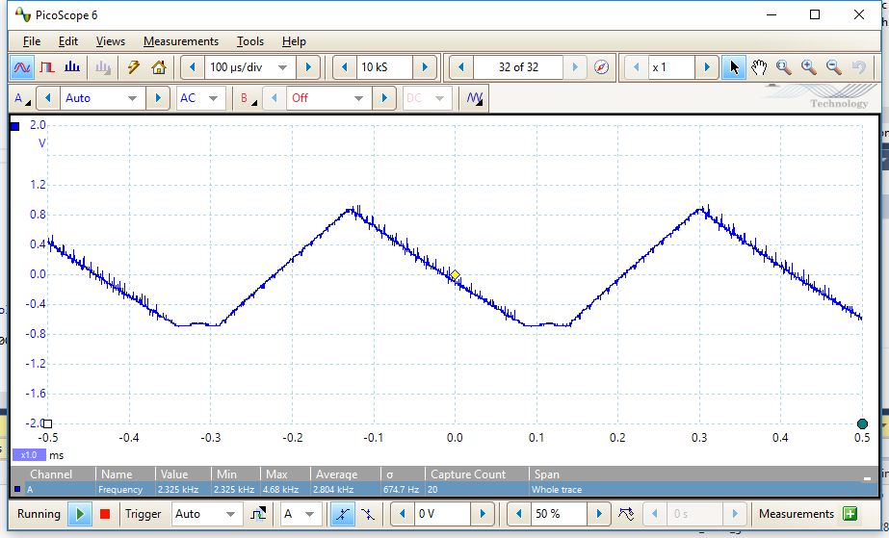
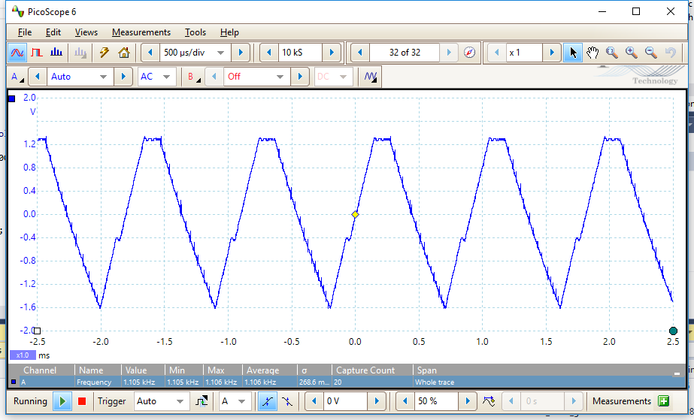
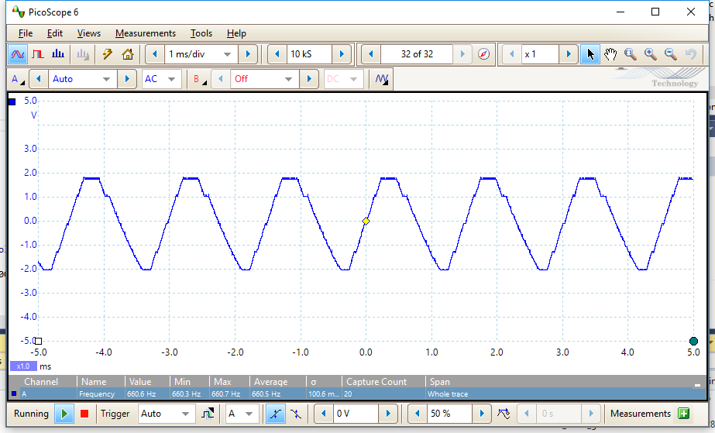
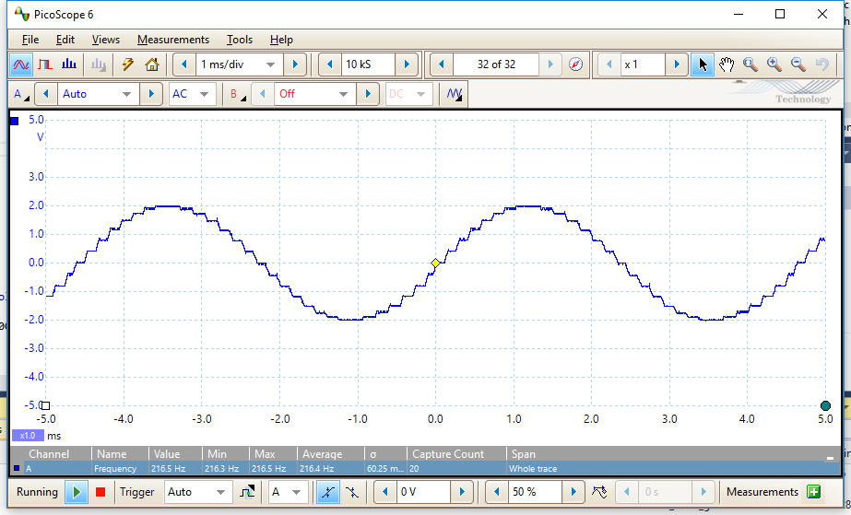
CALCULATED SINE FUNCTIONS
sample size: 6
frequency: 1100 Hz
sample size: 3
frequency: 2300 Hz
sample size: 10
frequency: 660 Hz
sample size: 30
frequency: 216 Hz

Slide 2
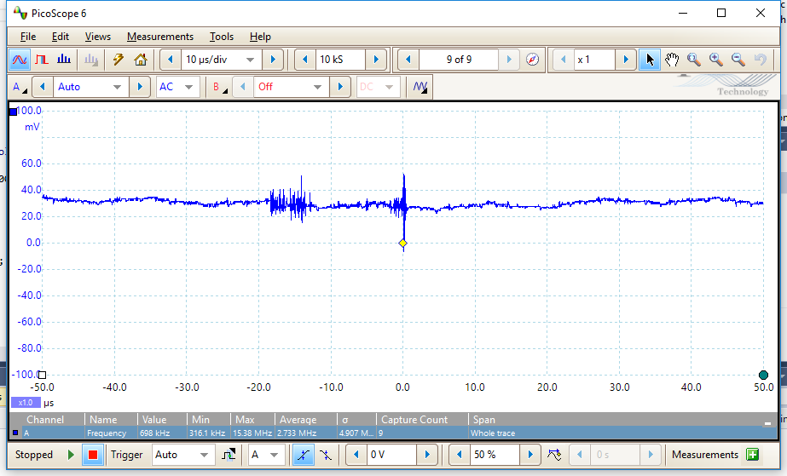
CALCULATED SINE FUNCTIONS
sample size: 10000
frequency: -

Slide 3
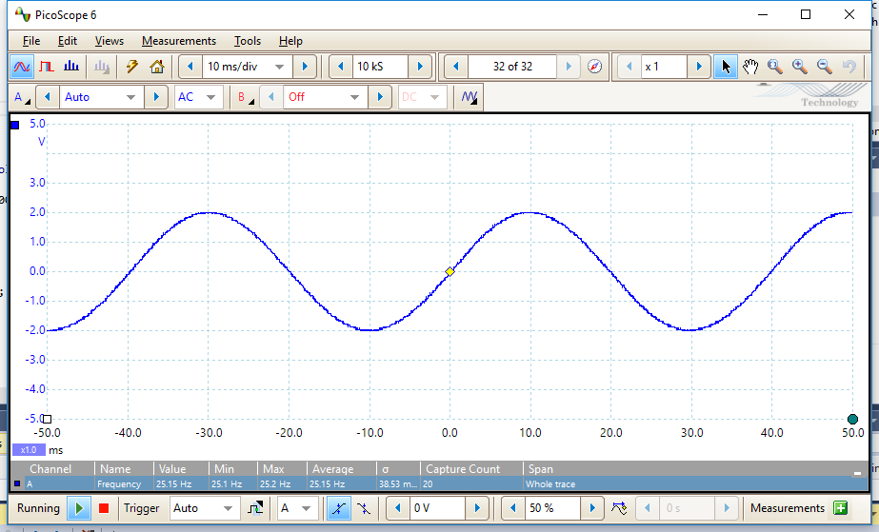
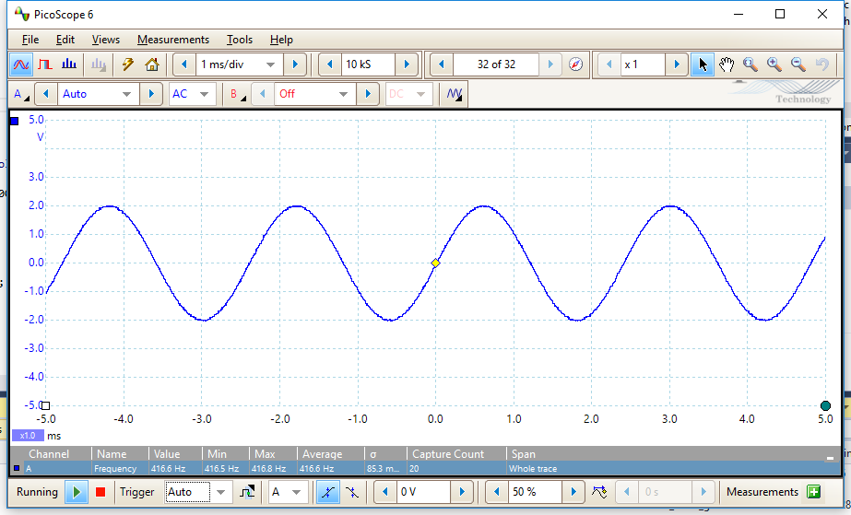
CALCULATED VS. LOOKUP SINE FUNCTIONS
CALCULATED
sample size: 256
frequency: 25 Hz
LOOKUP
sample size: 256
frequency: 416 Hz

